Slide 1
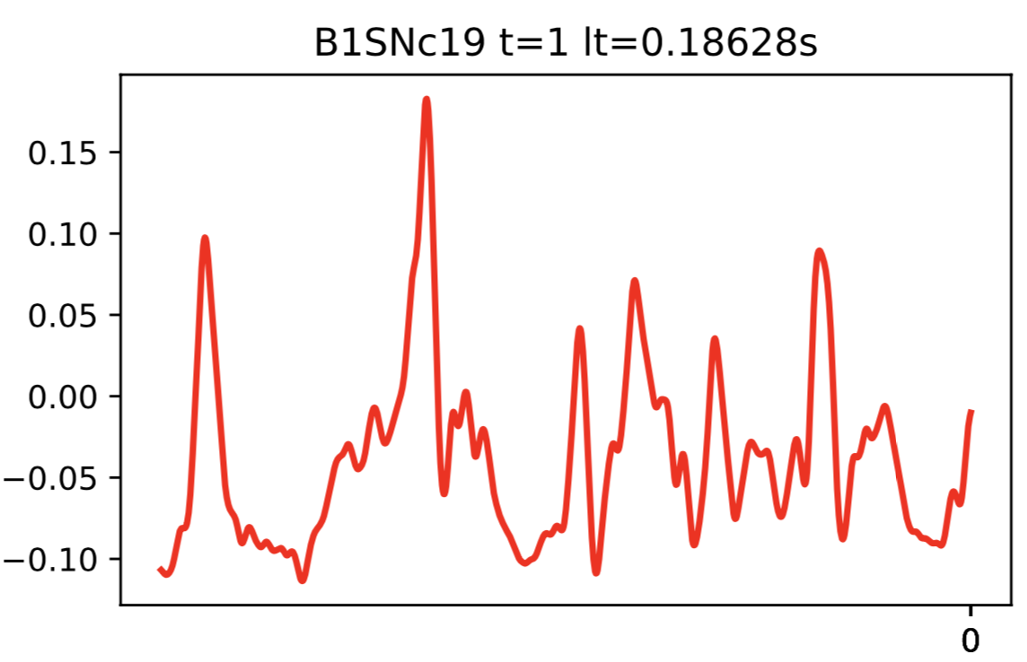
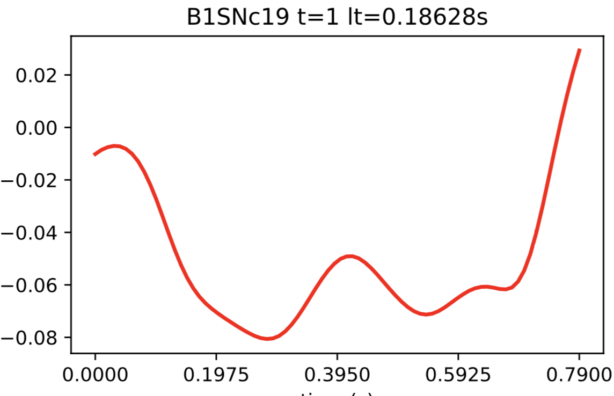
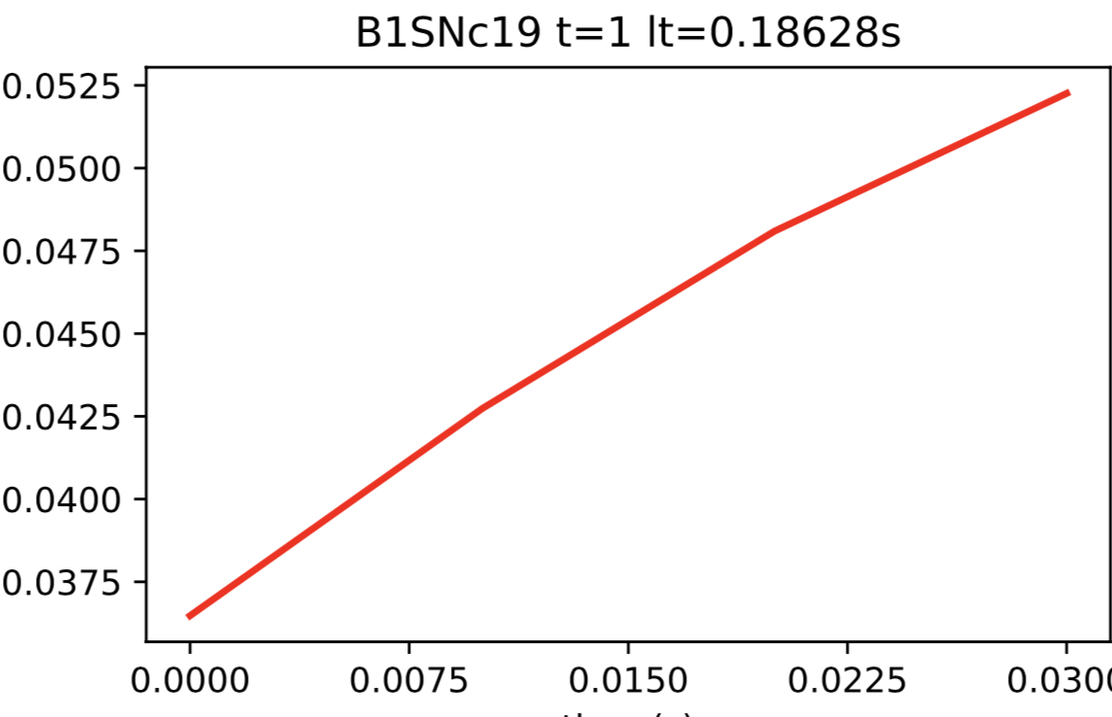
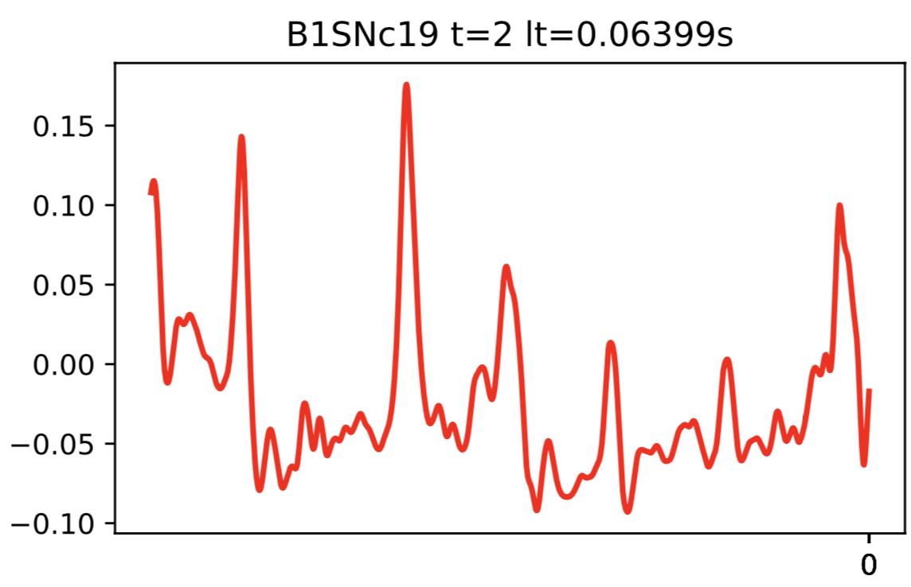
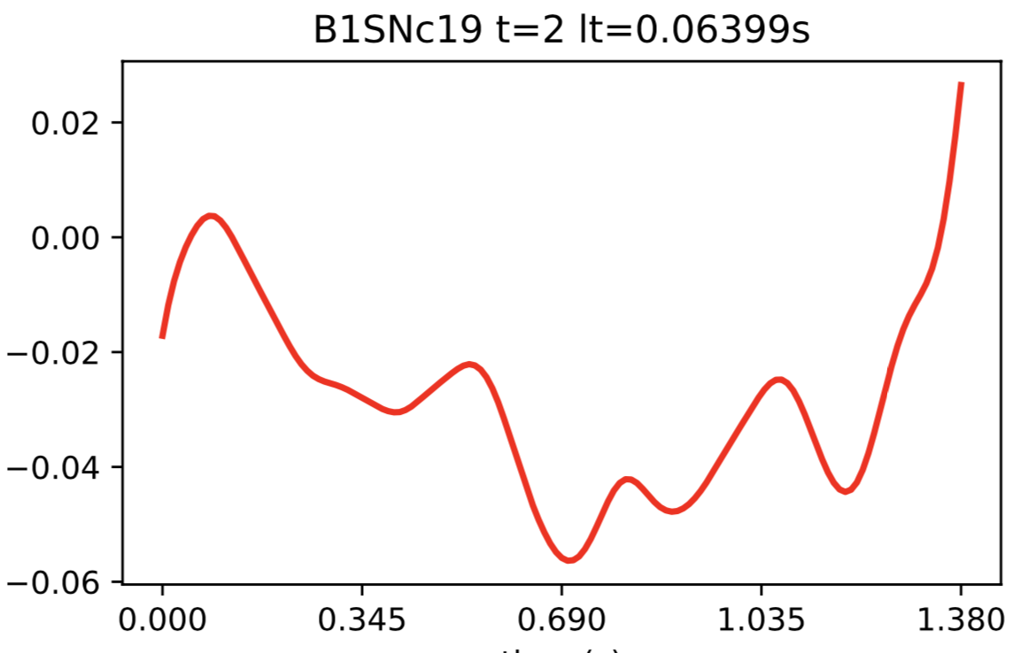
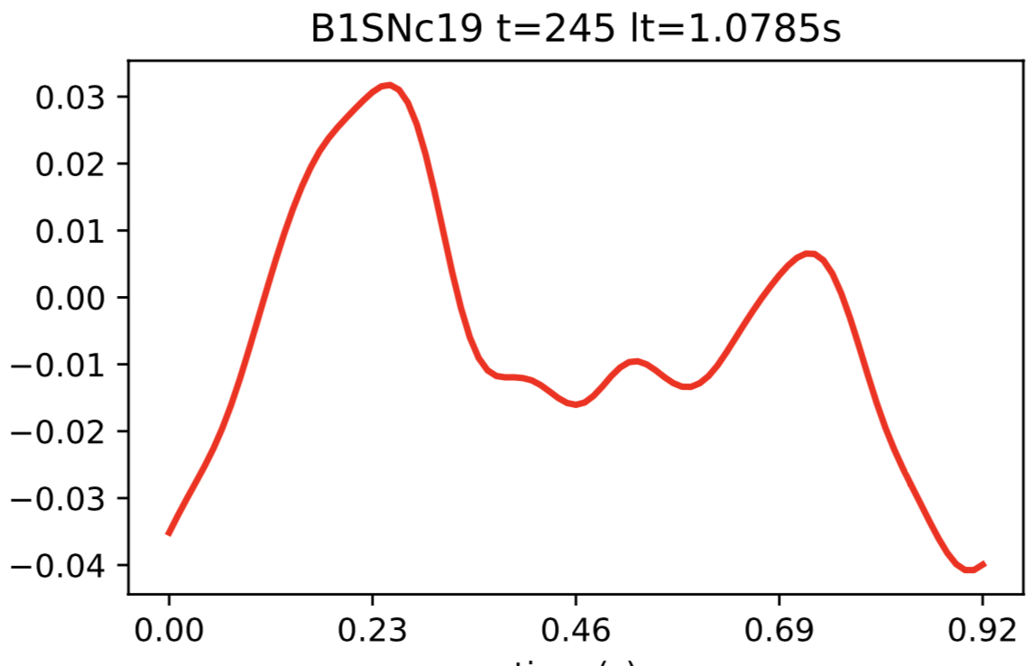
There’s no SINGLETRIAL component because we trimmed back!!!
As such, we need to probably also remove the indexed baseline and LOI – I bet we get errors because of this

Slide 2
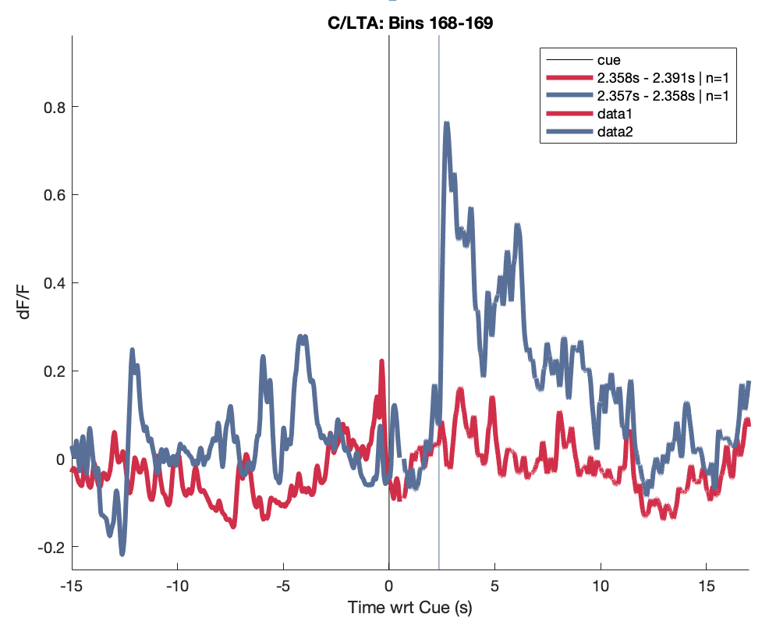
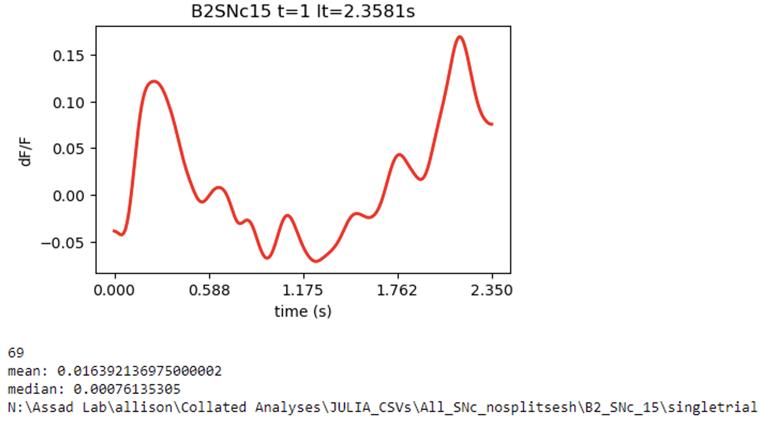
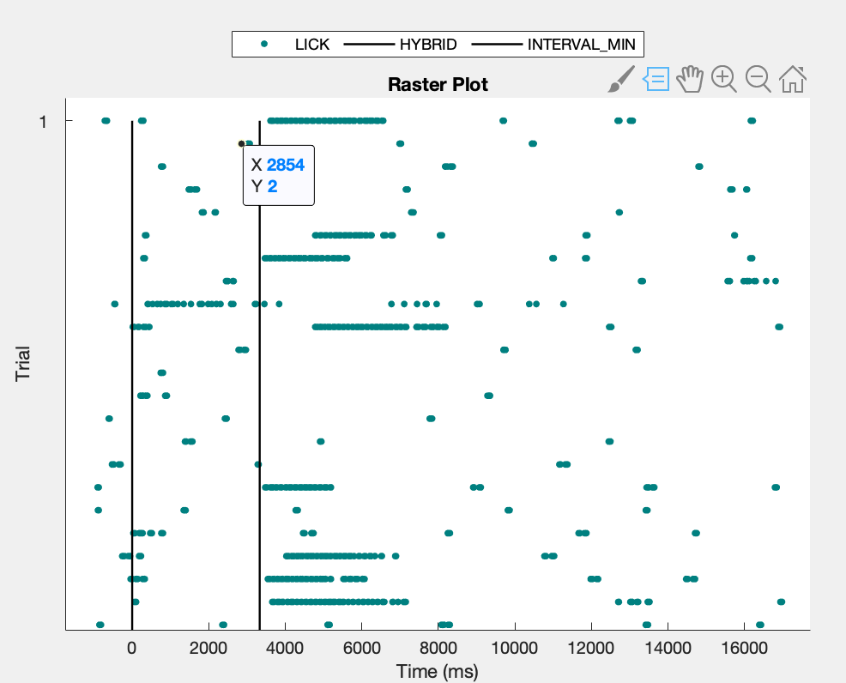
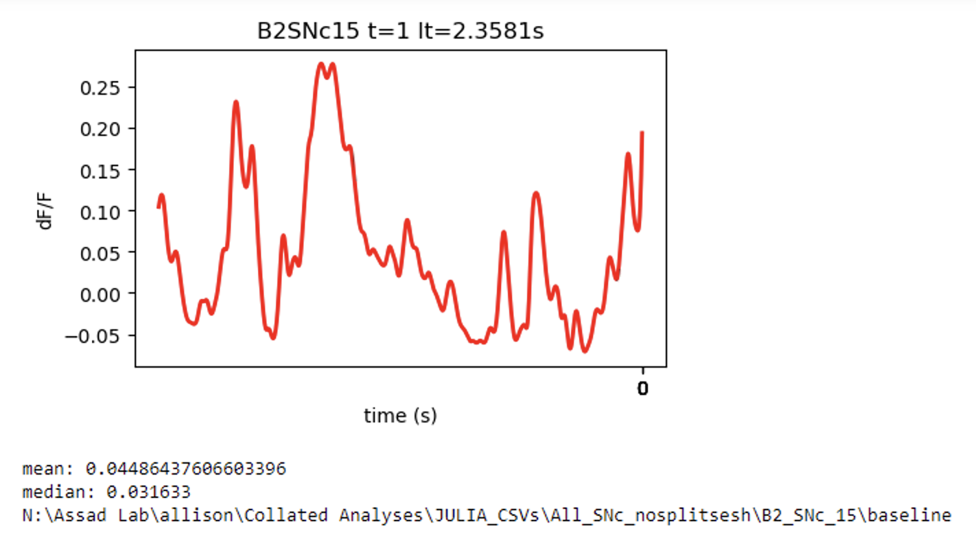
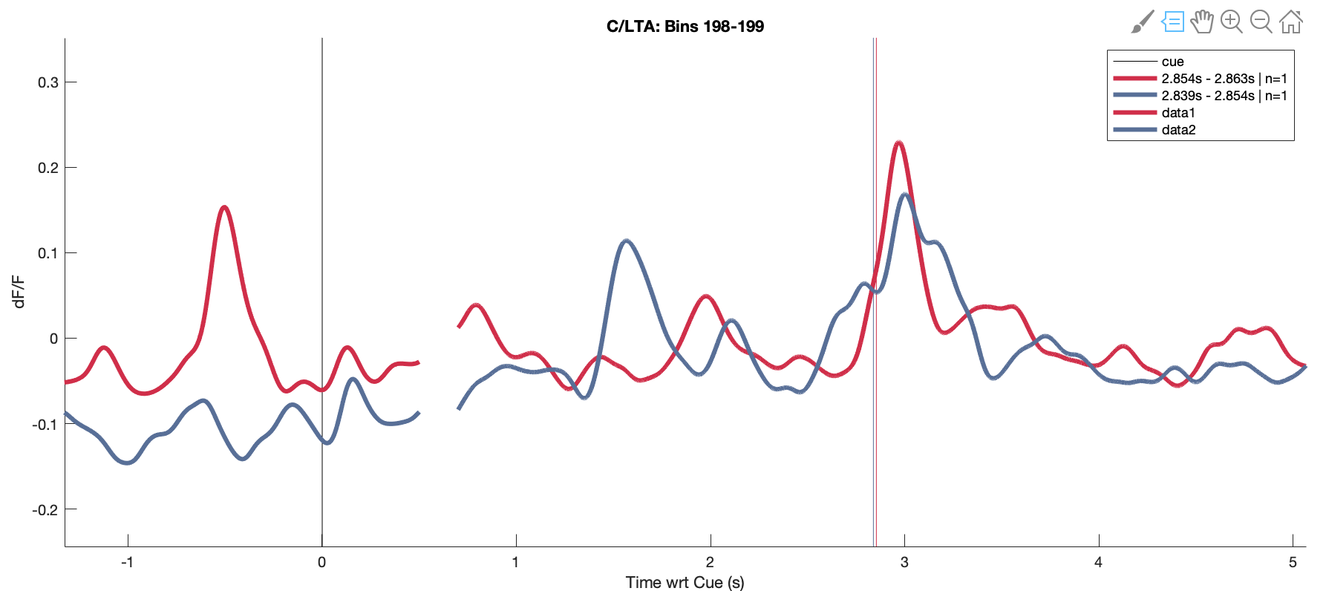
B2 day 15 SNc…. There’s trouble with trials 1 and 2. But seems to be ok by trial 3
Trial 1 is clearly rewarded (blue)…and raster says so too, but the timing is not recorded properly.
The interval seems reasonable, but note the bleed in the ITI
And LOI doesn’t extract at all…
I suspect there’s an extra cue or lamp off event screwing it up
Trial 3 (blue) looks right
We will remove trial 1 from the GLM analysis.

